Slide 1
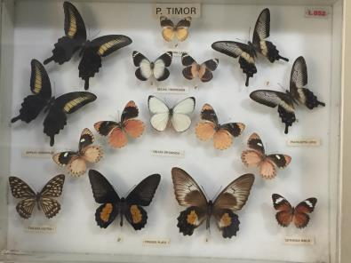
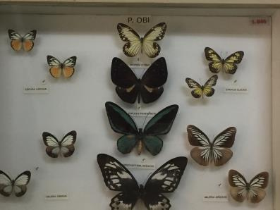
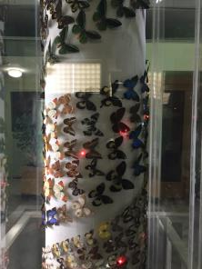
Visit to Butterfly Museum Rayyan

Slide 2
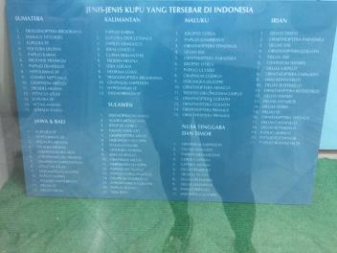
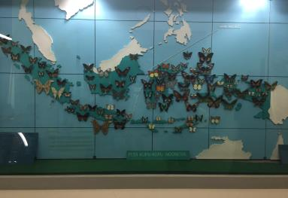
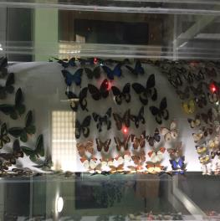
Indonesia is the home of a vast variety of Butterflies
There are more than 100 different kinds of butterflies in Indonesia
The most variety is located in Irian : 21 varieties
The least is located in NTB and Timor: 11

Slide 3
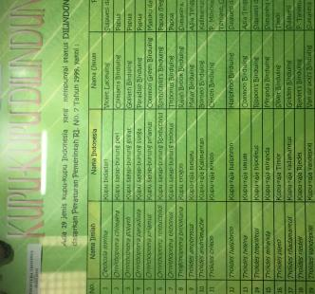
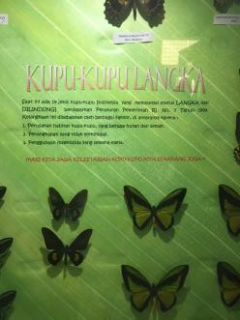
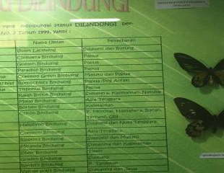
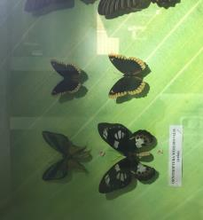
Out of 100 varieties, 19 varieties are endangered
They became endangered because:
Destruction of their habitat (forests, bush)
Illegal capturing
Use of pesticides

Slide 4
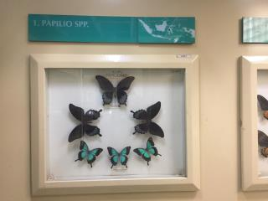
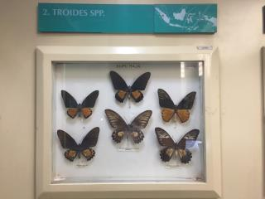
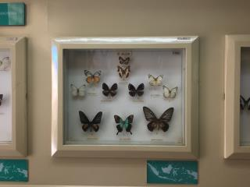
Butterflies vary based on the shapes, size and colors
There are hundreds of different color combinations on the butterfly wings
Butterflies also vary in sizes and shapes of their wings
Butterflies from eastern Indonesia are more colorful

Slide 5
