Slide 1
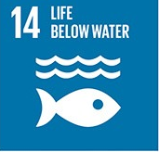
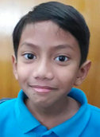
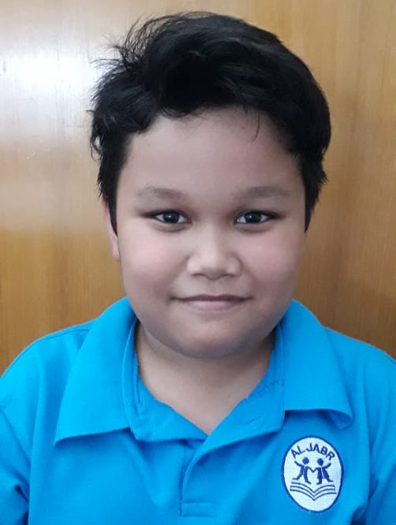
Trash below water has impact to organism and their habitat
Members : Farrel, Abram, Dinda, Zachry, Rasya
Mentors : Ms. Riani, Mr. Adi S, Ms. Fanny, Ms. Ulfah

Slide 2
Learns through inquiry
Transdisciplinary theme: How The World Work (the impact of scientific and technological advances on society and on the environment)
Central Idea: “Trash below water has impact to organism and their habitat”
Lines of inquiry:
How the organism relies on habitat below water with effected environment
How citizens relies on animal habitat, by following the rules
Using recent technology to help clean the dirty and long river

Slide 3
Key Concept
Form: What system that is use to clean the river?
Function: What is the function of a clean river?
Causation: What caused dirty river?
Change: How do we clean the water river?
Connection: how does dirty river affect people and its surrounding
Perspective: What are the impacts throwing trash to the river?
Responsibility: How to we help to make the river clean?

Slide 4
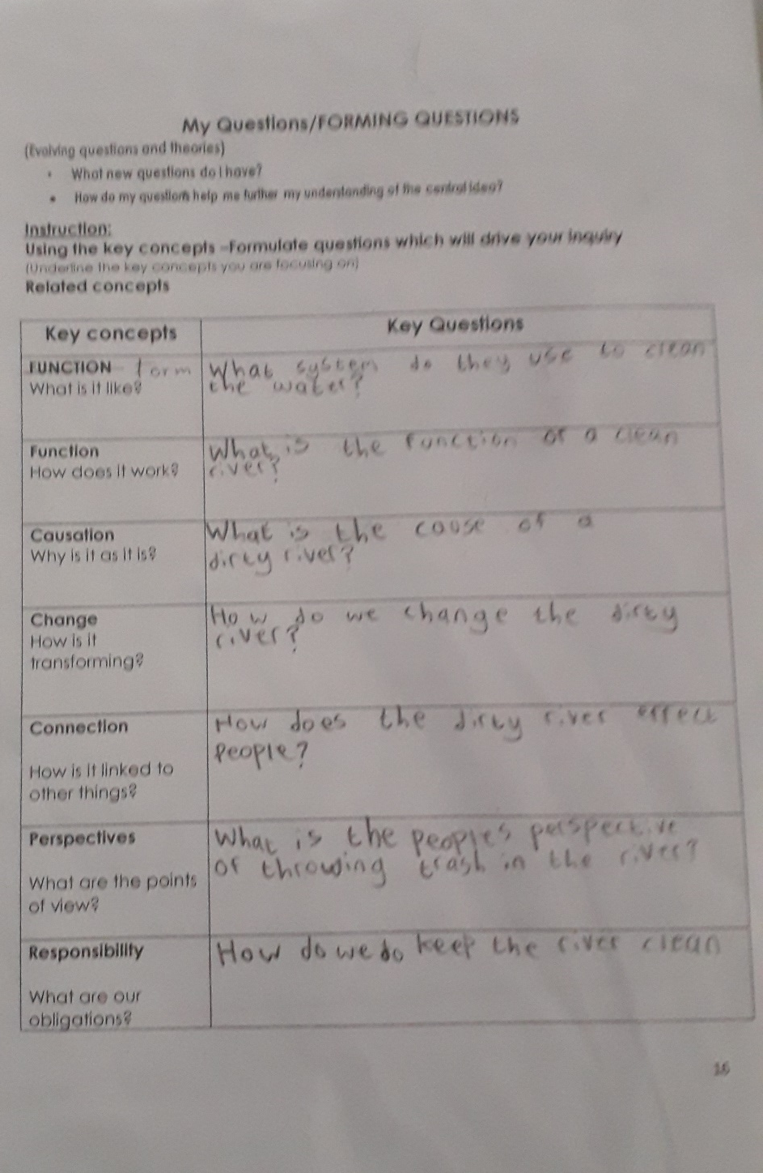
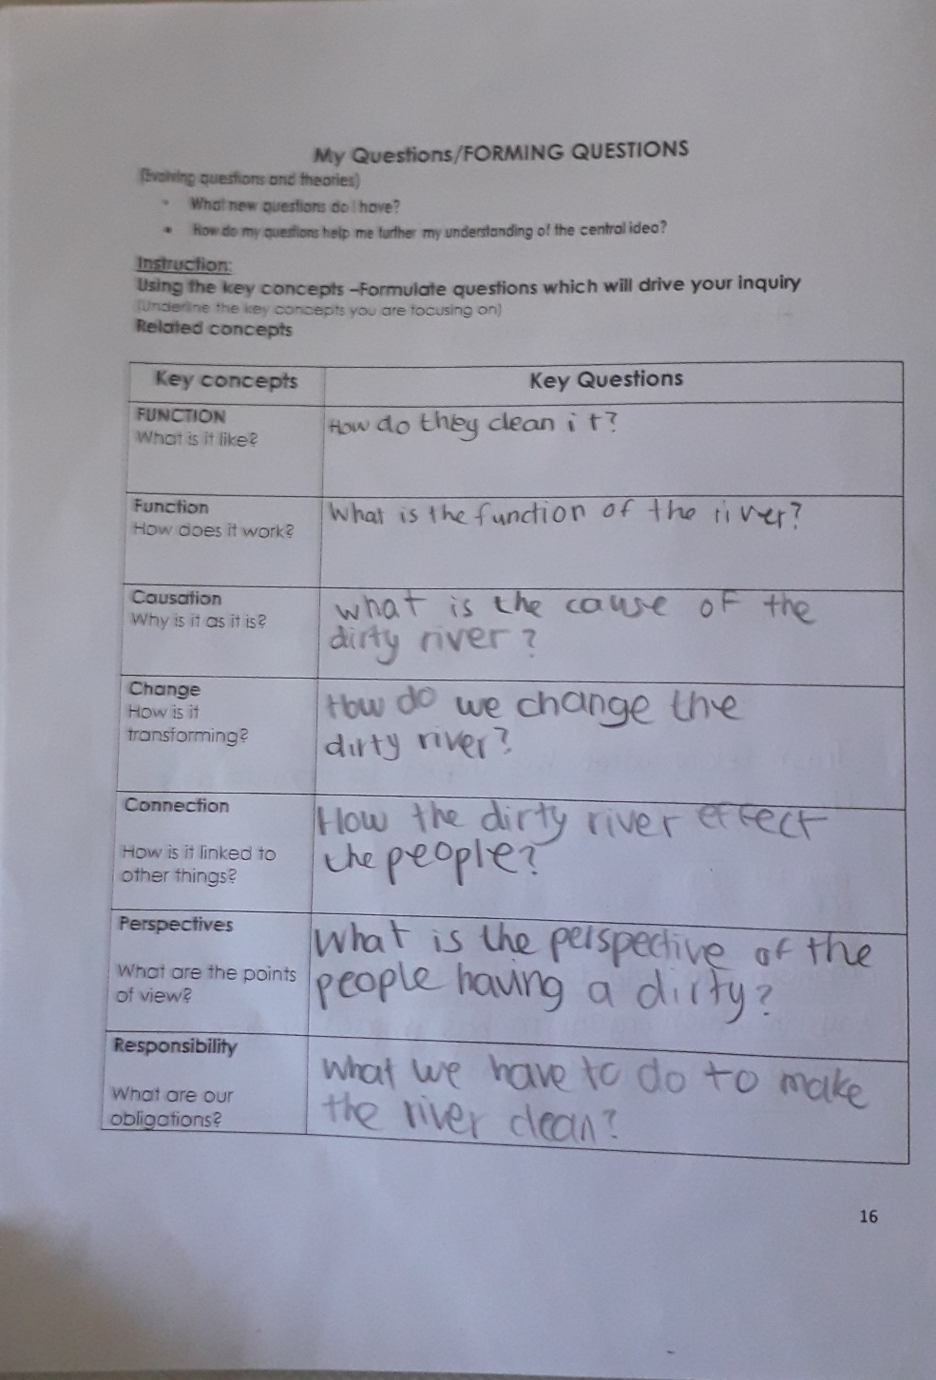

Slide 5
Prior Knowledge:
Science Invention and sustainability of the Earth’s resources (G1), Human interaction to natural habitat (G2),
Changes in the Earth, Scientific knowledge, and Biodiversity.
Quran Verses:
Telah tampak kerusakan di darat dan di laut disebabkan karena perbuatan tangan manusia Allah menghendaki agar mereka merasakan sebagian dari (akibat) perbuatan mereka, agar mereka kembali (ke jalan yang benar).” (QS. Ar-Rum 41)

Slide 6
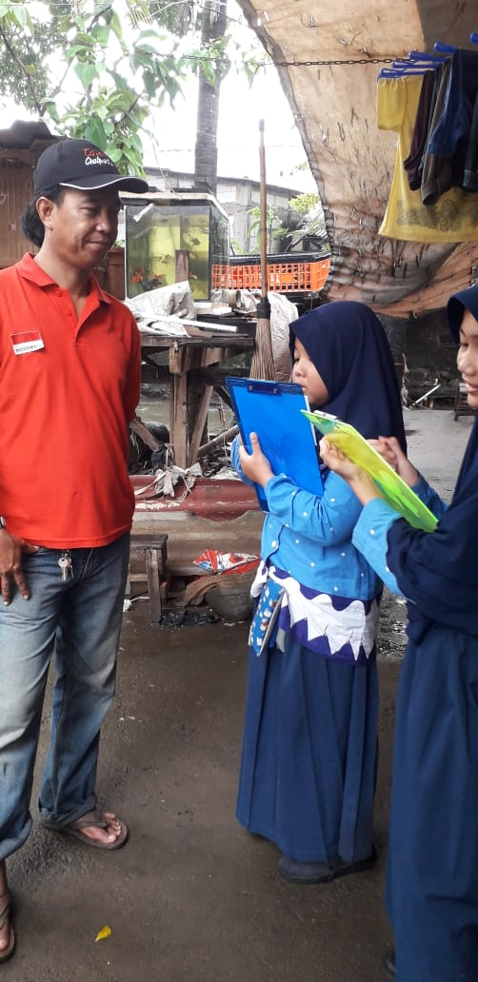
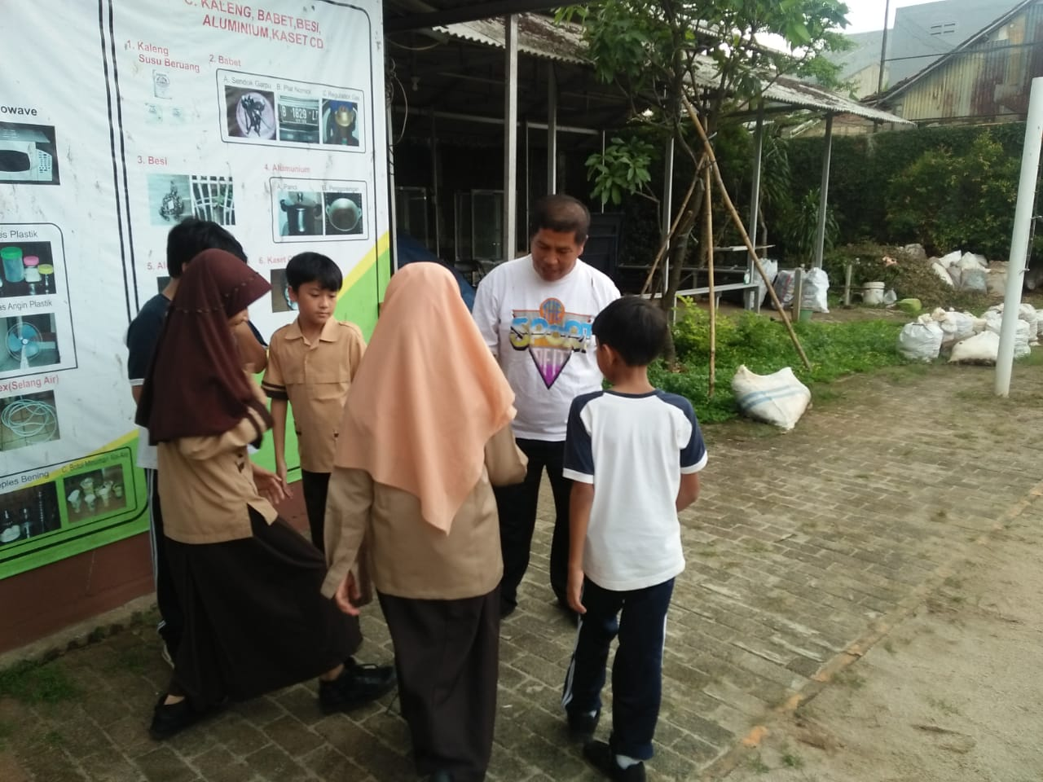
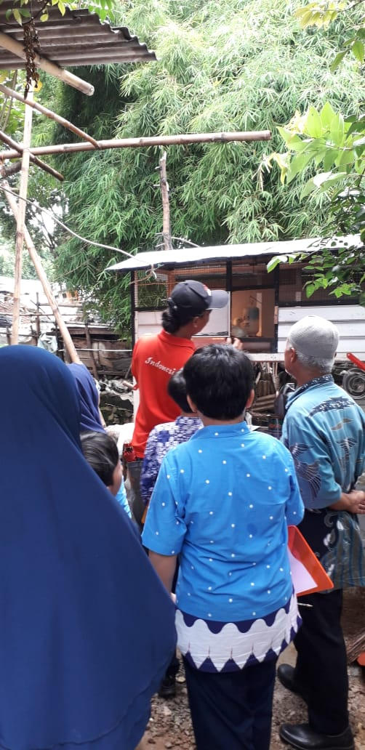
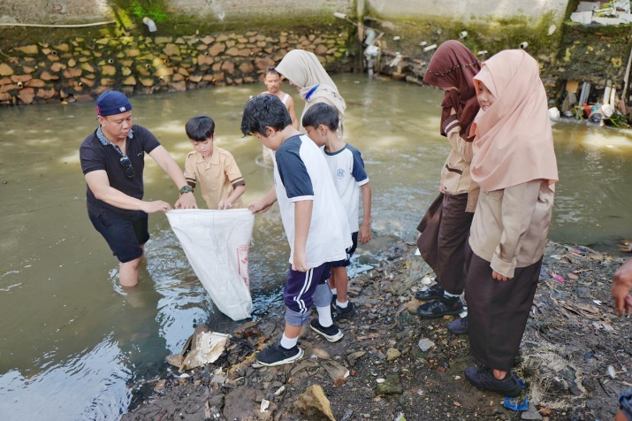
IB Profiles Inquirer Communicator Risk-Taker

Slide 7
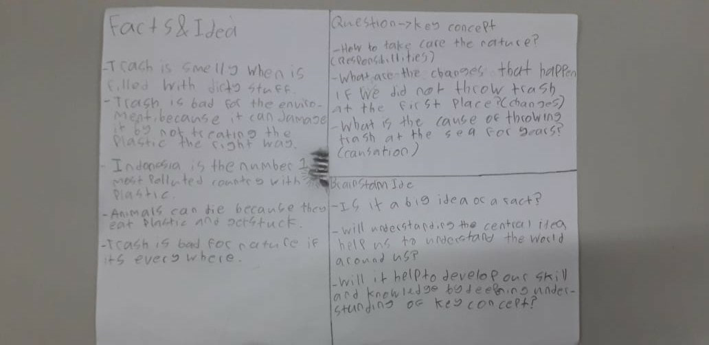
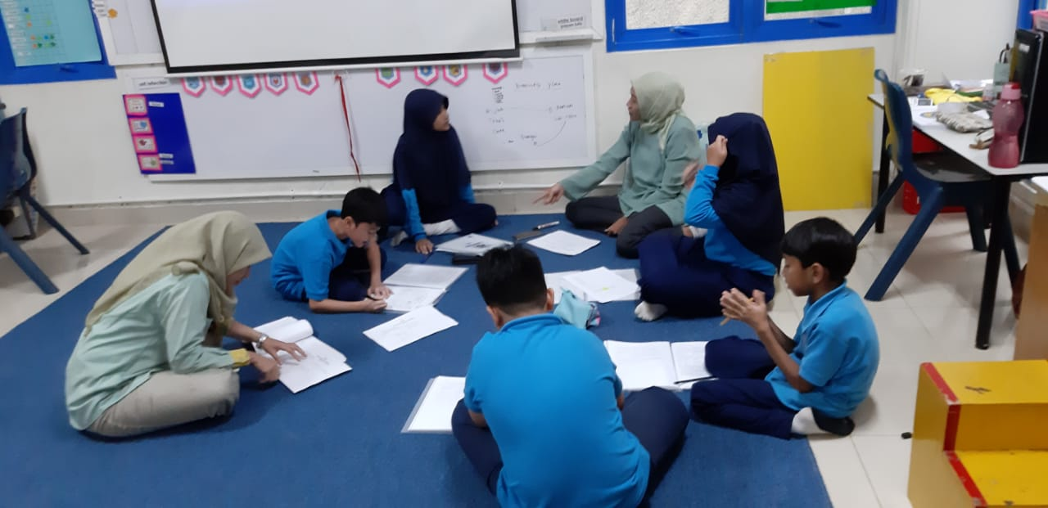
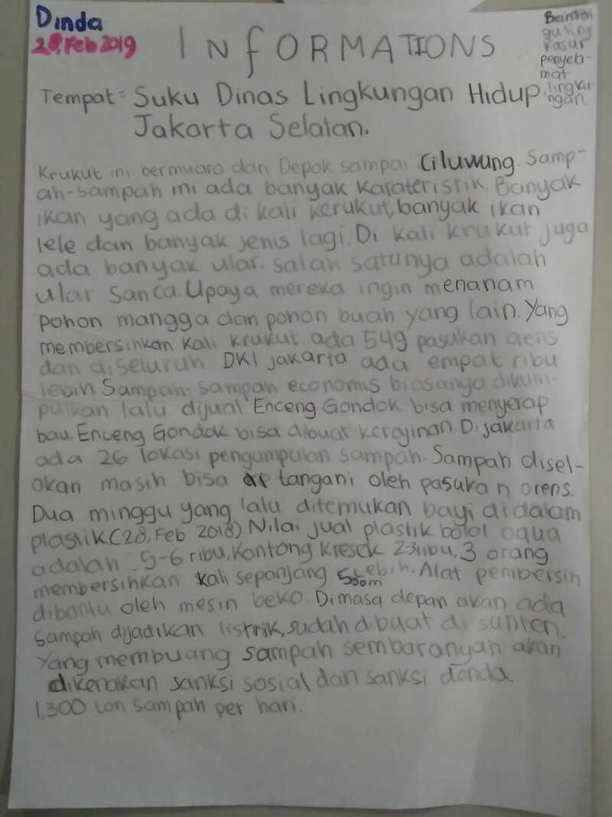
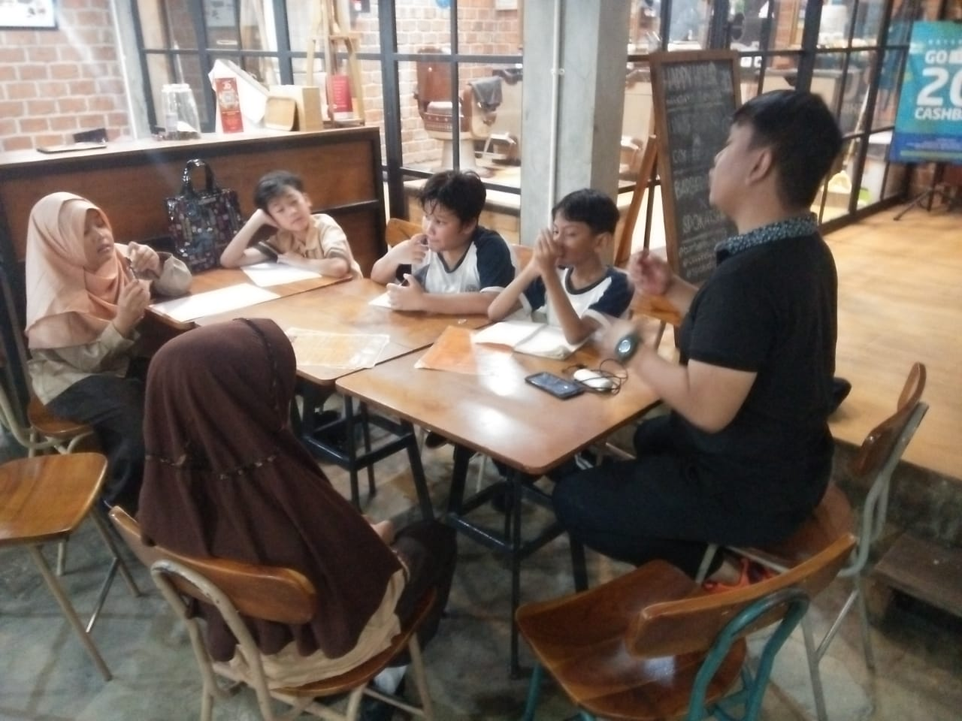
ATL ATL Skills
Research Skill
Thinking Skill
Research skill Thinking skill

Slide 8
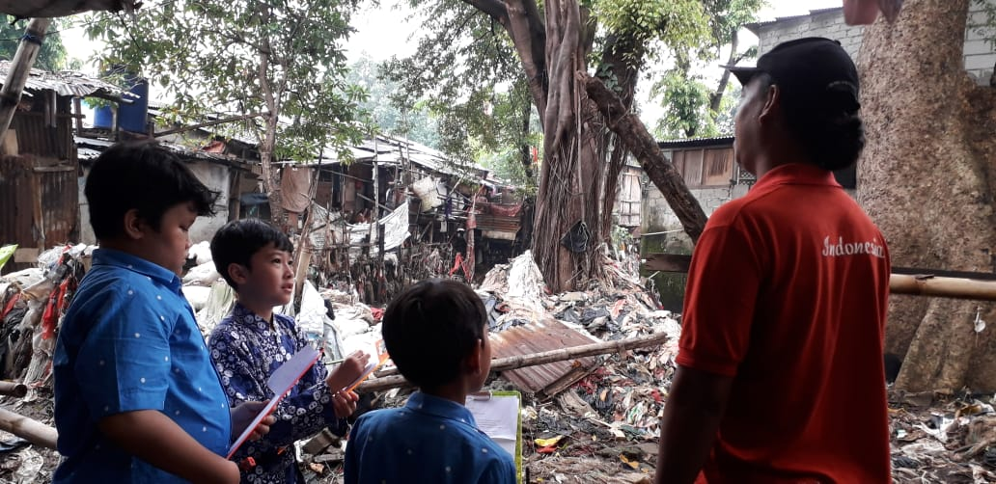
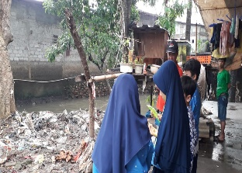
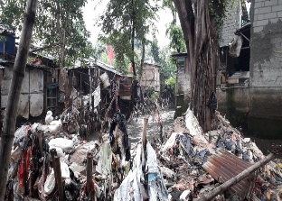
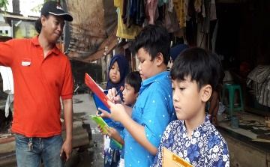
COLLABORATES TO PLAN LEARNING AND TEACHING
Fieldtrip to Krukut River

Slide 9
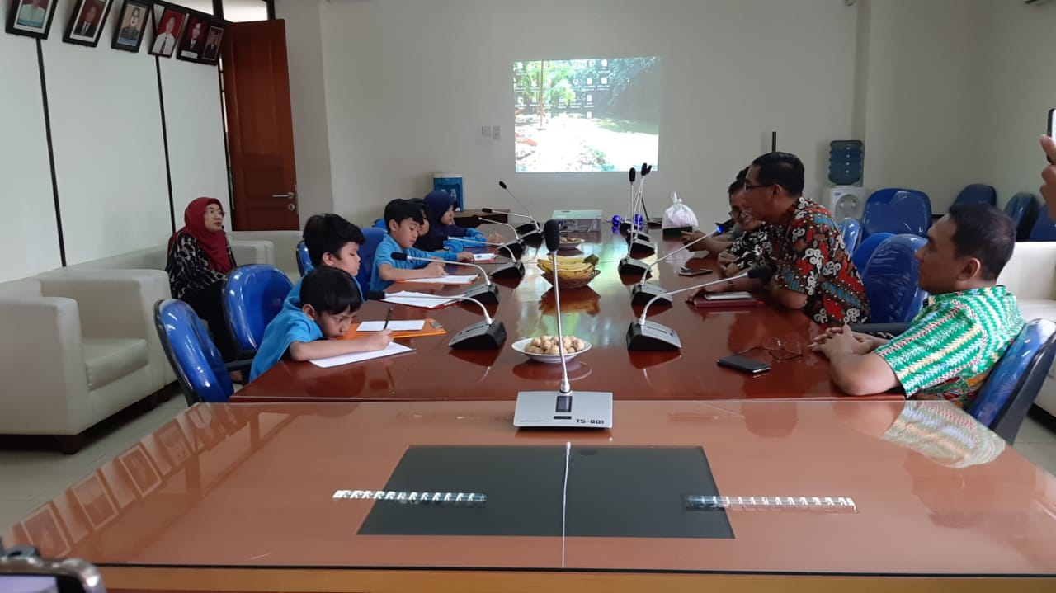
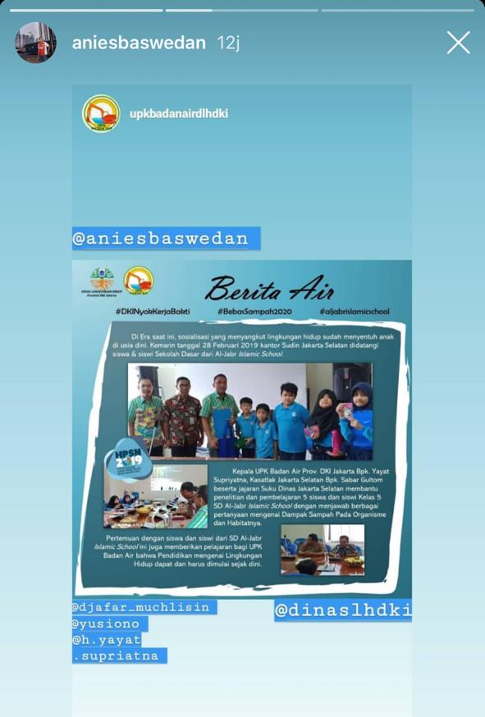
Fieldtrip to Suku Dinas Lingkungan Hidup

Slide 10
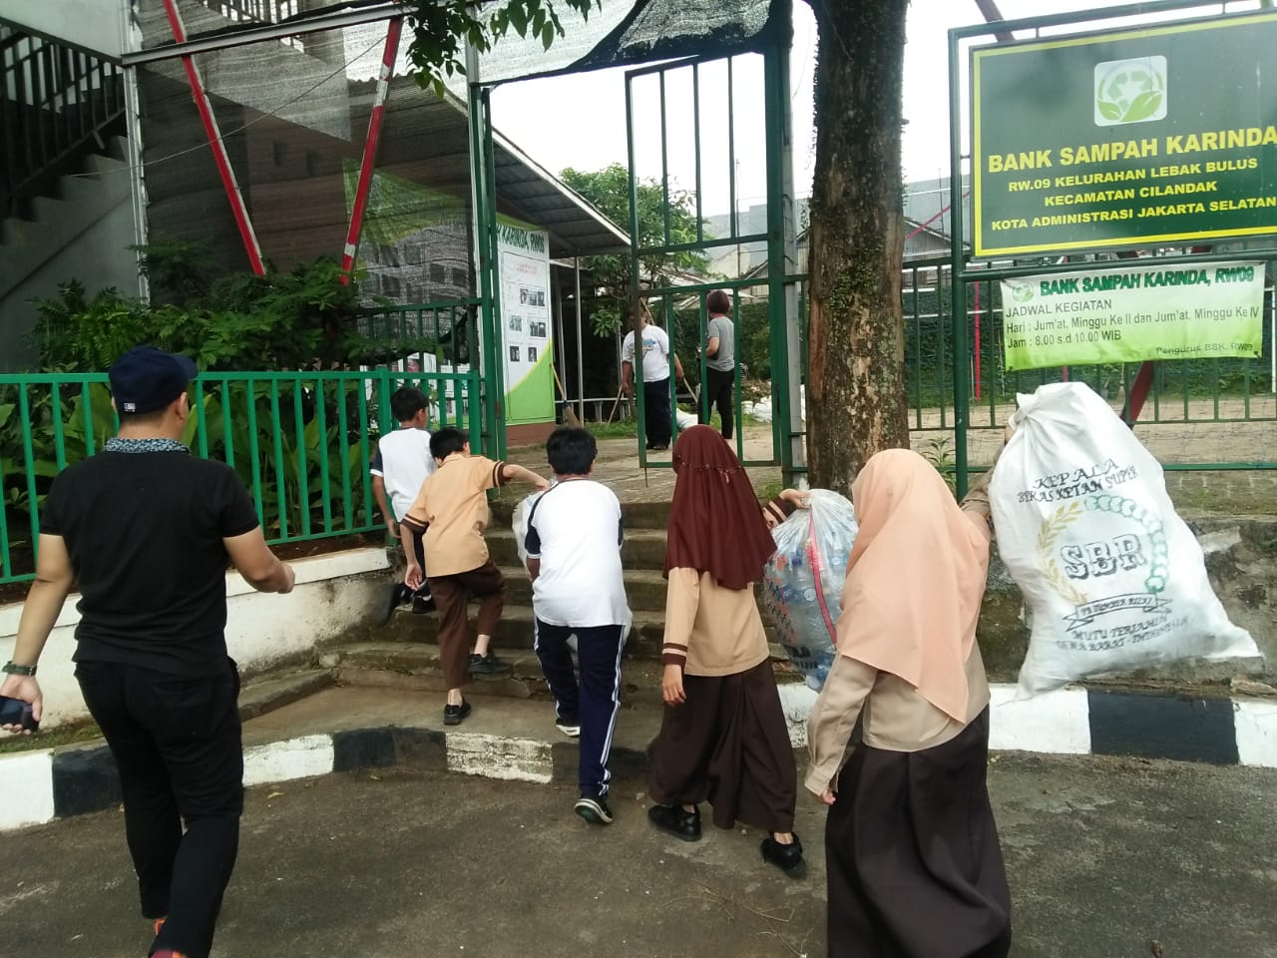
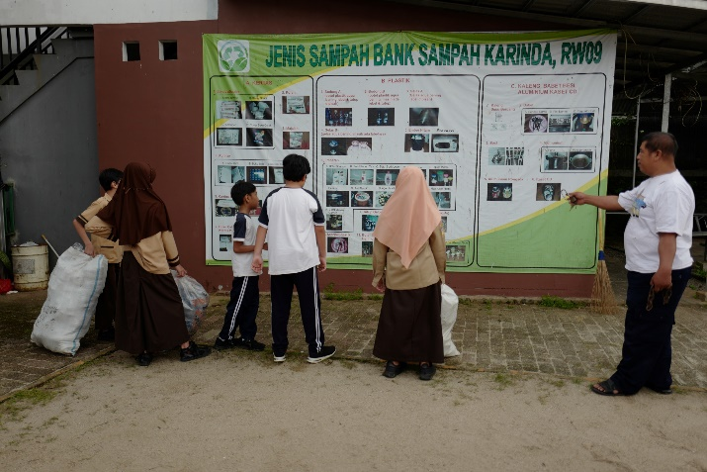
KARINDA TRASH BANK

Slide 11
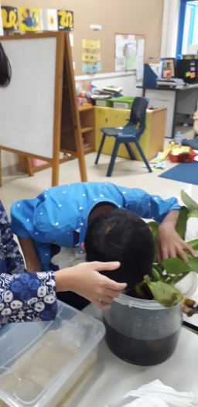
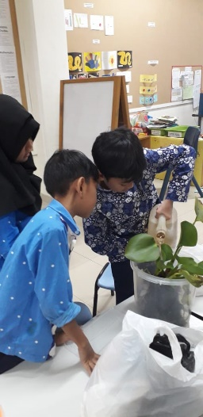
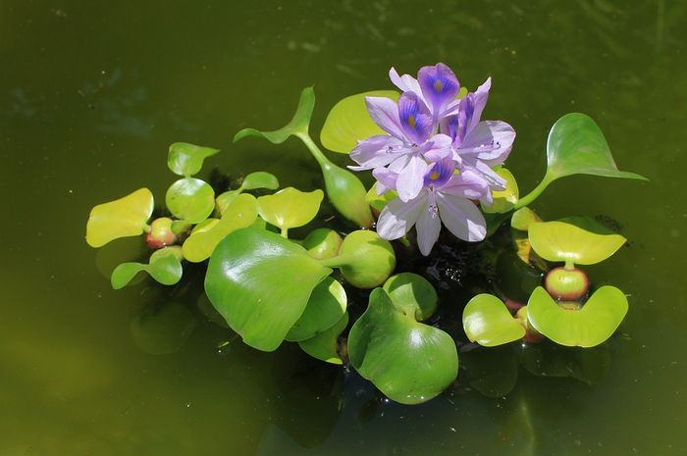
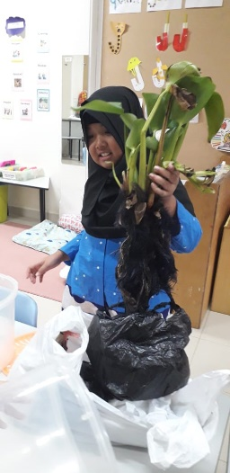
OUR EXPERIMENT
Water Hyacinth

Slide 12
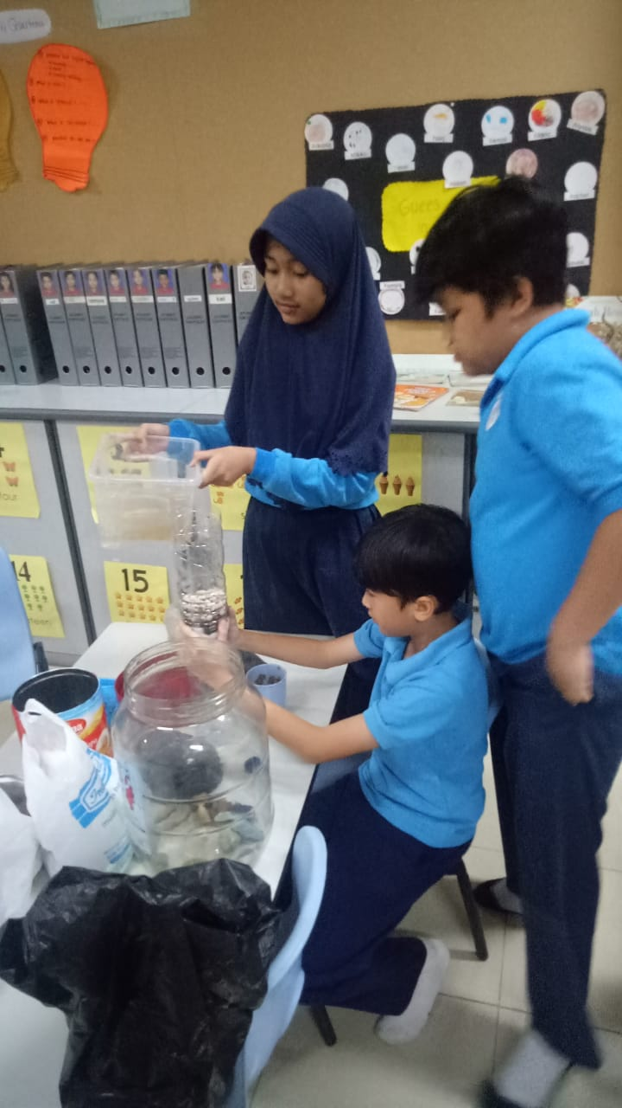
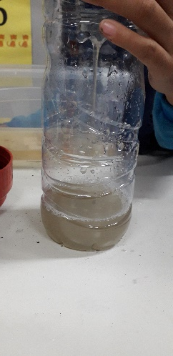
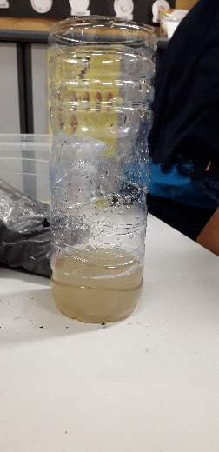
Water Filtration

Slide 13
Sets learning goals and success criteria
Learning Goals | Success Criteria
Identify how the organism relies on habitat below water with effected environment | We are able to identify how citizens work on their ways to make their environment clean.
Analyze how citizens relies on their environment, by following the rules | We are able to analyse how government requires the citizen to implement the rules.
Recognize government short and long-term action to clean the river | We are able to recognize government short and long-term action to clean the river.

Slide 14
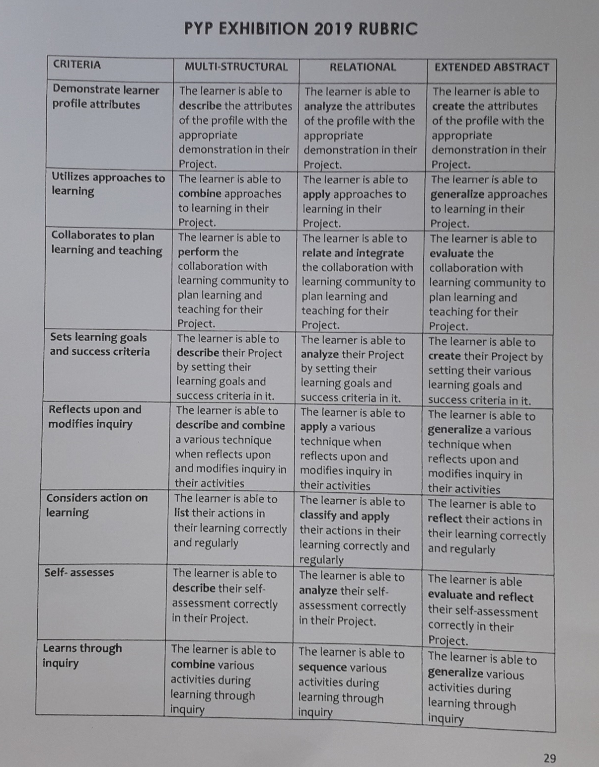

Slide 15
Reflects upon and modifies inquiry
Inquiry Process (Generating ideas)
Researched
Reflection of the learner profiles
Get the data after visited the Krukut river and Dinas Lingkungan Hidup
Science Experiment
Risktaker
Thinker
Inquirer

Slide 16
Reflects upon and modifies inquiry
Describe (what happened)
Accepted feedback
Connected science fact with the social life
Express feeling
Challenging (Blended POI)
Interesting and fun (experiences)

Slide 17
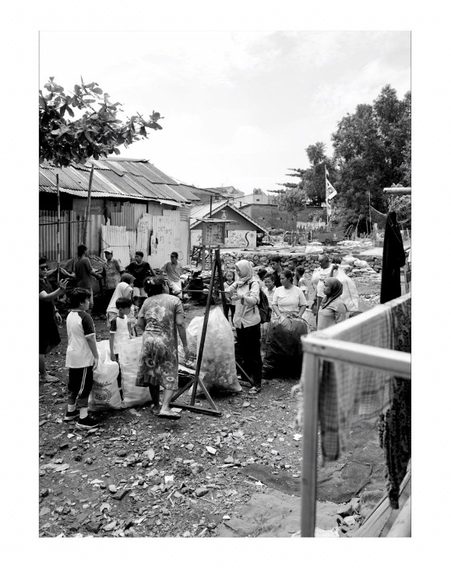
Considers action on learning:
Participation

Slide 18
Self- assesses
Plus
The government also has a plan to work together with Japan.To make a recycling center in 2020.
Minus
Lack of citizen awareness about the cleanliness around their living.
Citizens that live around the river can easily get sick.
We knew government already has a real action to make and keep the river clean.
Idea
Promote to the citizen that there are a lot of trash bank to help them manage the trash that they have
Persuade the citizen how to manage trash to become something useful.

