Slide 1
Technology of Infrastructure Construction
Members : Ryu, Zemma, Steyr, Nayra Mentors : Ms.Beta, Ms.Hana, Ms.Asti,Mr.Rio

Slide 2
Learns through inquiry
Transdisciplinary theme: How the World Works
Central Idea: Scientific Knowledge is constantly evolving and has impact on human life.
Lines of inquiry:
How government systems function
How decision-making practices reflect human rights
Impact of government on citizens
Concepts: Change, Connection, Responsibility
Related concept: Ingenuity, progress, ethics, and sustainability

Slide 3
Learns through inquiry
Prior Knowledge:
Grade 2 : Building and structure Grade 3 : Natural disaster
Grade 4 : Energy/organic waste Grade 5 : Simple machine
Al Qur’an Quotes:
Allah has sent down water (rain) from the sky, then streams of water in the valleys according to their size, then the currents bring forth bubbling bubbles. And from what (metal) they melt in the fire to make jewelry or tools, there are (in fact) bubbles like the current bubbles.
Thus Allah makes the parable of the righteous and the false. As for the foam, it will disappear as worthless; as for the benefit of man, he remains on earth. Thus Allah made parables. (Ar Rad-verse 17)

Slide 4
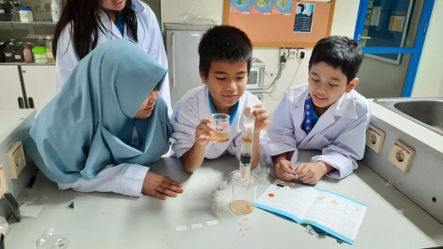
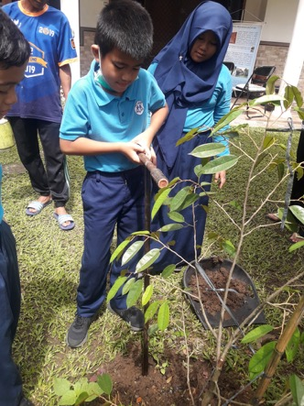
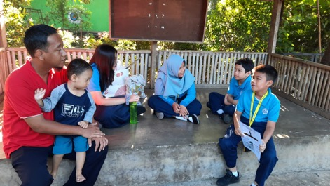
IB Profiles and ATL skills
Inquirer
(Research Skills)
Risk-Taker
(Social Skills)
Communicator
(Communication Skills)

Slide 5
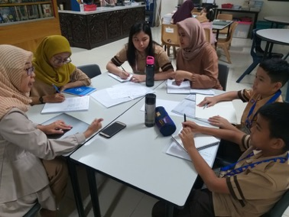
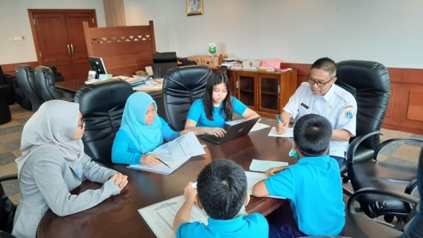
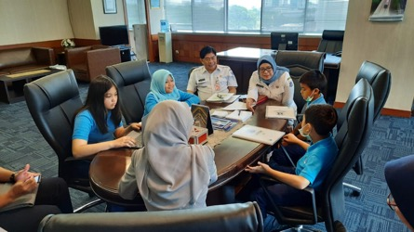
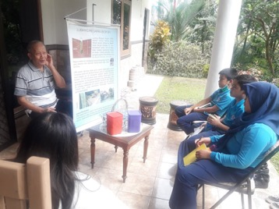
Collaborates to Plan Learning and Teaching
Mentor meeting and discussion
Collect data about the roles and responsibilities of
government (Ext. of BAPPENAS) to support Jakarta Infrastructure and technology.
We visit the inventor of Bio pore technology;
Dr. Kamir Prof. Pariadin Broto
as a lecturer and expertise of Soil Biotechnology IPB
We visited Deputy Governor Human settlement and spatial planning in Jakarta Capital City Government.

Slide 6
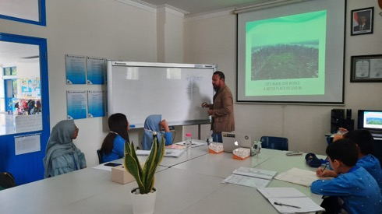
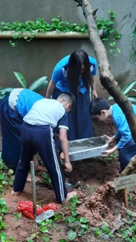
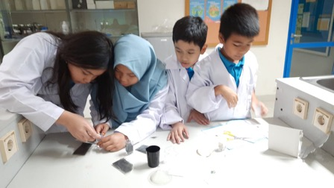
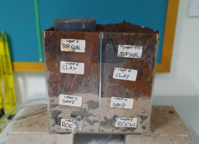
Guest Speaker : Ir. Lindung Bayu Kumara Tungga Dewa (Civil Architect)
BIOPORE INFILTRATION HOLES EXPERIMENT AT SCHOOL
SOIL LAYERS AND WATER INFILTRATION EXPERIMENT
Create and design a model of biopore infiltration holes

Slide 7
Sets learning goals and success criteria (refer to learning goals and success criteria in exhibition journal)
Learning Goals | Success Criteria
Analyse cause and effect of drainage system in infrastructure construction towards the environment | We can identify local significant issue caused flood in Jakarta We can find the background problems of this issue We can organize the information from the research findings We can describe the effect of infrastructure towards living things/non-living things and also the ecosystem
Create and design bio-pore infiltration holes technology for soil and water conservations | We can apply our knowledge through different products and actions We can relate understanding and experiencing into Bio-pore experiments We can reflect our knowledge by sharing information to the local community We know how to report of infrastructure issues to government’s platform and media

Slide 8
Reflects upon and modifies inquiry
Inquiry Process (Generating ideas)
Generating ideas needs to be in a sequence and scientific following the theory of knowledge
Reflection of the learner profiles
Our learner profiles that we focusing on is realistic and applicable with our topic
Describe what happened
Express feeling
Action planning is succeed and conducted as our plan that we have visited different places which are:
Be a thinker with the resources that related to our issues taken from trusted references
Al-Hasaniah school
Margastawa community
Media Platform Jakarta Smart City and JAKI
Enthusiastic to do reserach
Reflective to evaluate our strength and weakness and also next steps actions
Caring and communicator to share our knowledge and understanding

Slide 9
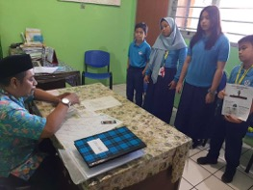
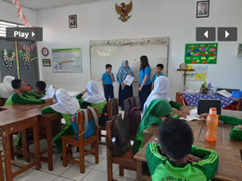
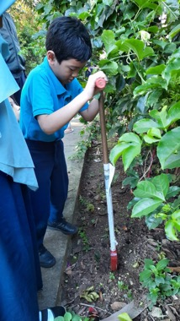
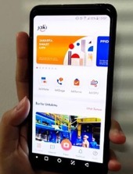
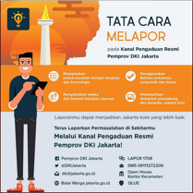
Considers action
on learning:
2. ADVOCACY
3. PARTICIPATION
1. SOCIAL ENTERPRENEURSHIP

Slide 10
Self- assesses
Being a communicator by sharing our knowledge about how to minimize over flowing water to prevent flood.
Being a risk-taker by designing and creating Bio-pore Infiltration holes cooperatively.
Self-management skills by submitting the task on time according to mentors’ deadline.
Research skills by following the procedures when conducting the Bio-pore experiment
Be confidence when we share our idea.
Be creative and critical thinking to create and design of experiments materials
Be principled to follow our group agreements

