Slide 1
REFLECTION OF FIELD TRIP
By: Vaskar & Bahi

Slide 2
What we wanted to know in LIPI
We wanted to know the general things about coral bleaching like, the process & what is the aftermath after the coral bleaching. We were also looking for the connection between corals and other animals/plants like Sea Turtles & Sea Grass.

Slide 3
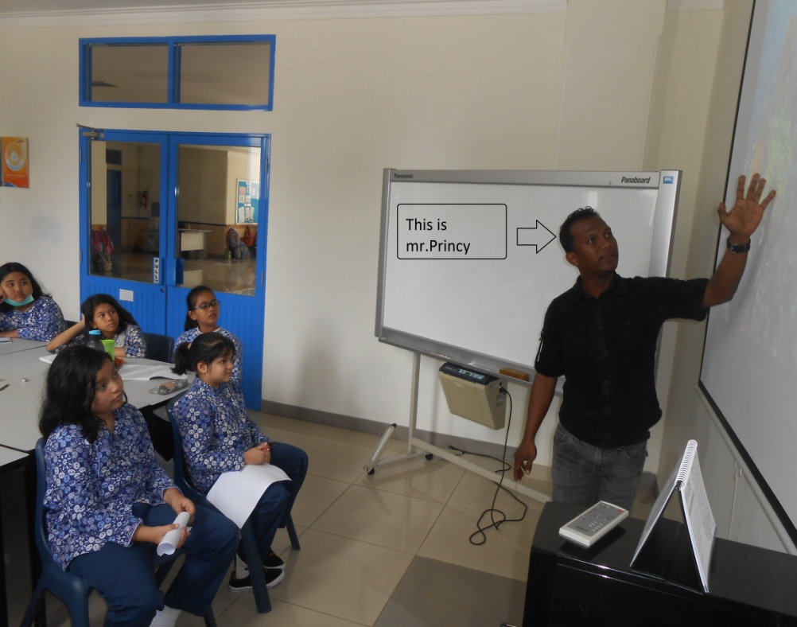
What we wanted to know from Mr. Princy
We wanted to know kinds of corals & we wanted to know deeper about the coral life cycles & we asked some of the questions that LIPI didn’t answered.

Slide 4
What we learnt from LIPI
In LIPI, we learnt about the process of coral bleaching & how long it takes for a healthy coral to be bleached. We also learnt about the connection between Corals & other animals/plants like Sea Turtles and Sea Grass.

Slide 5
What we learnt from Mr. Princy
We learned about connections between corals & other living things in the sea, types of coral reef, marine ecosystem further, since corals have important roles for them as well.

