Slide 1
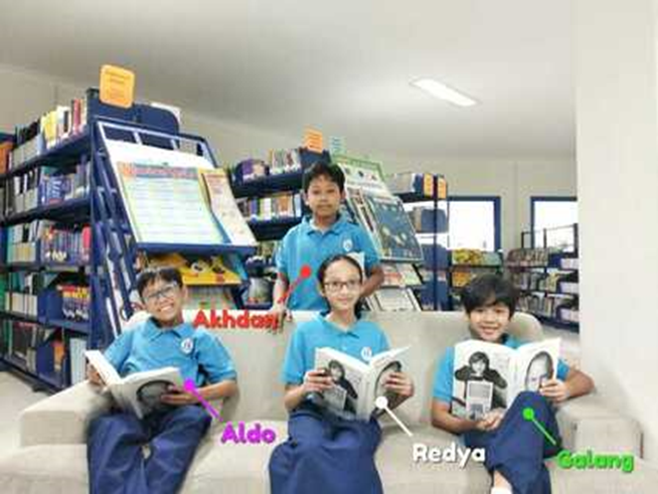
Scientific Technology to Support Human Activity Contaminant Soil in Agriculture Treat Soil Health and Productivity
Members : Akhdan, Galang, Aldo & Redya
Mentors : Mr. Ryan, Ms. Hana & Ms.Reza

Slide 2
Learns through inquiry
Transdisciplinary theme: How The World Work (the impact of scientific and technological advances on society and on the environment)
Central Idea: Humans rely on constantly evolving and sustainable technology to support soil health and productivity in contaminants of agriculture
Lines of inquiry:
Government involvement in management of agricultural activities
How human interaction affects the environment
The role of technology in scientific understanding
Prior Knowledge: Science Invention and sustainability of the Earth’s resources, Human interaction to natural habitat, Changes in the Earth, Energy transformation Simple machine, Scientific knowledge, and Biodiversity.
Quran Verses Al ARAF: 58
Dan tanah yang baik, tanaman-tanamannya tumbuh subur dengan seizin Allah;dan tanah yang baik tidak subur, tanam-tanamnnya hanya tumbuh merana. Demikianlah kami mengulangi tanda-tanda kebesaran (Kami) bagi orang-orang yang bersyukur.

Slide 3
Key Concepts
Change
Responsibility
Function
What is the function of agricultural technology in this era?
How can people improve soil health and productivity?
What are the government responsibilities to support agricultural activities?
Related Concepts: Sustainability, progress, ingenuity, and ethics

Slide 4
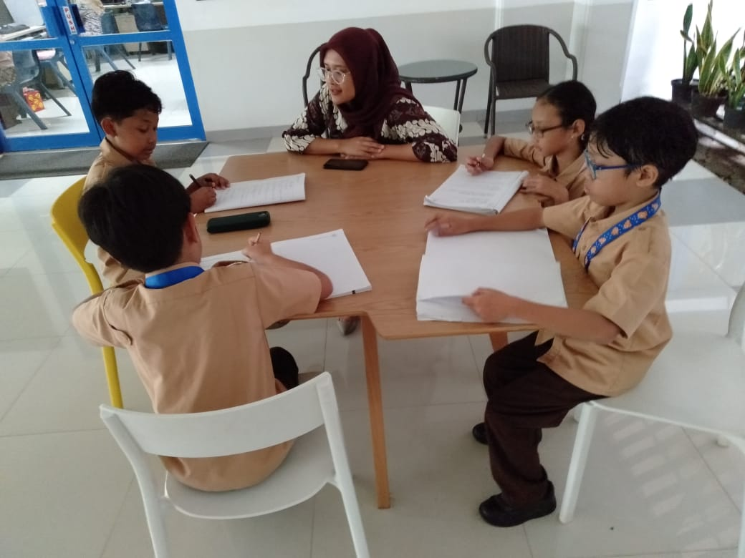
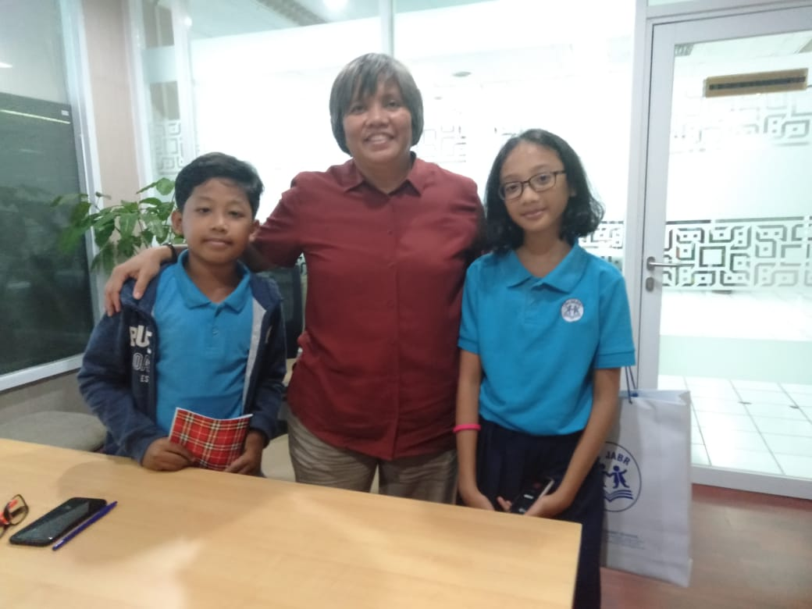
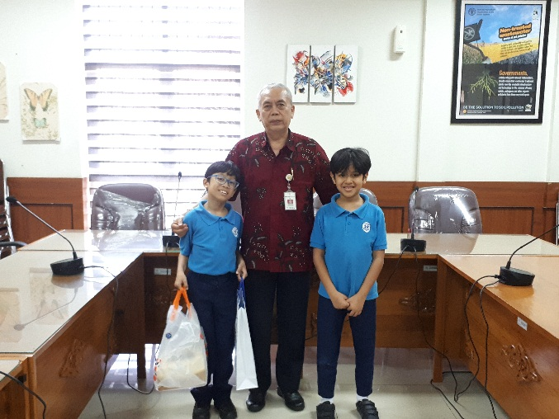
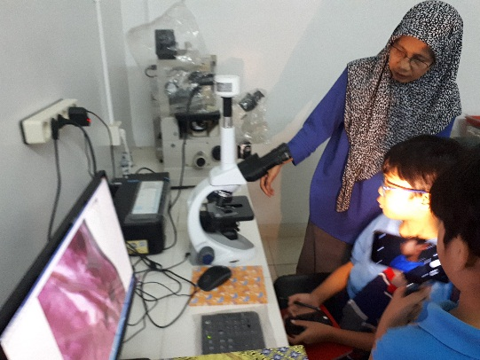
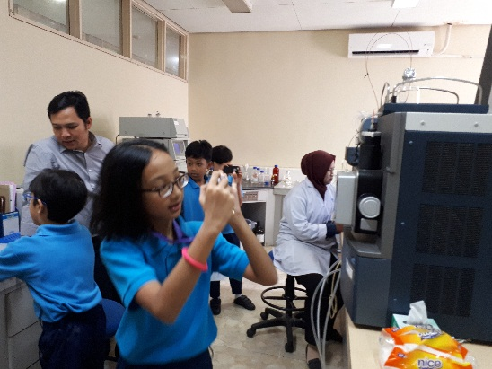
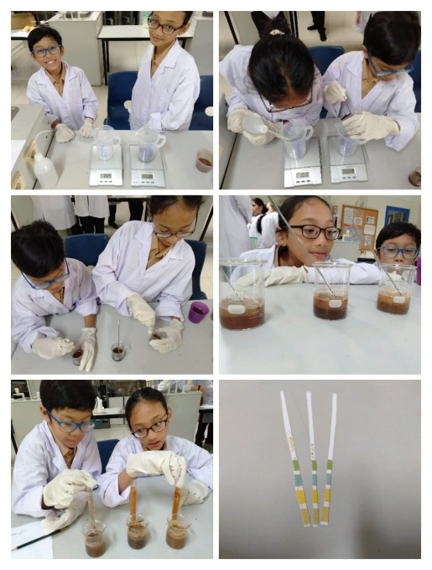
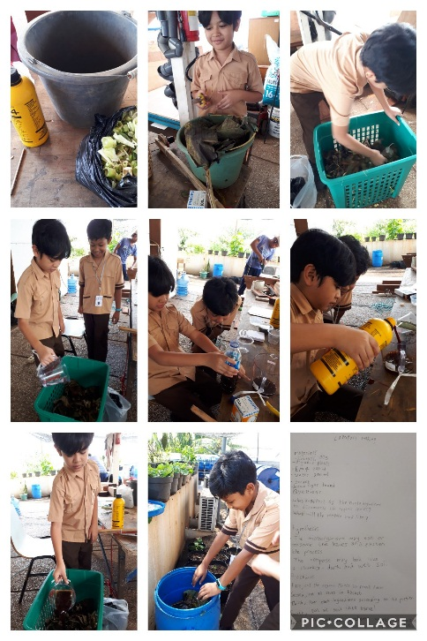
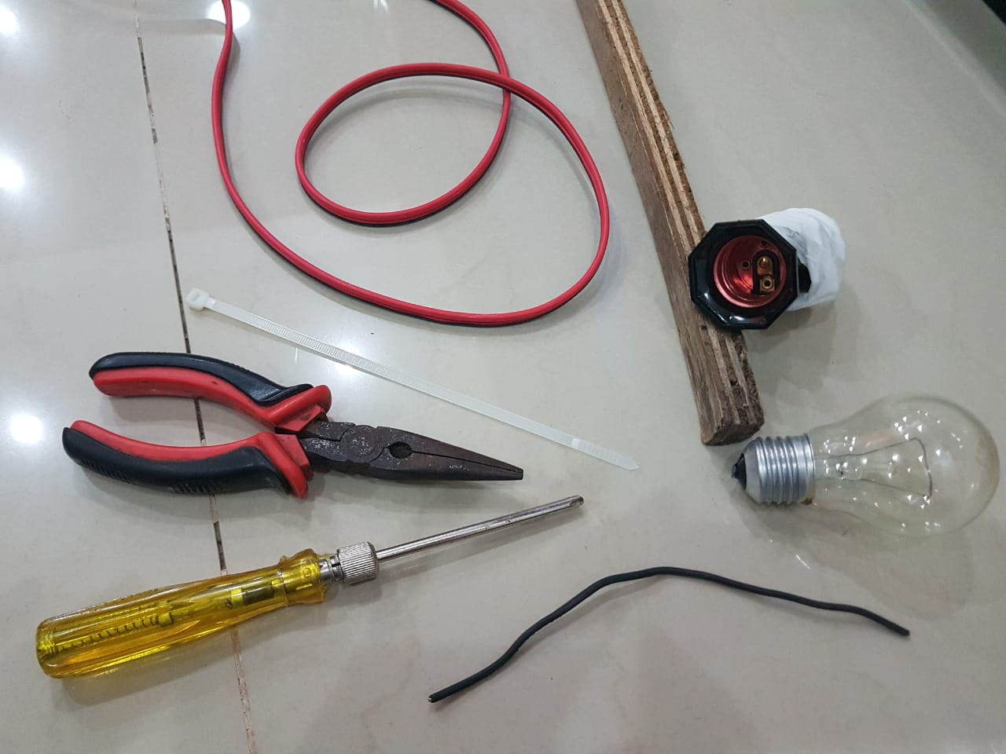
Demonstrate learner profile attributes
Inquirer, Thinker, & Principled

Slide 5
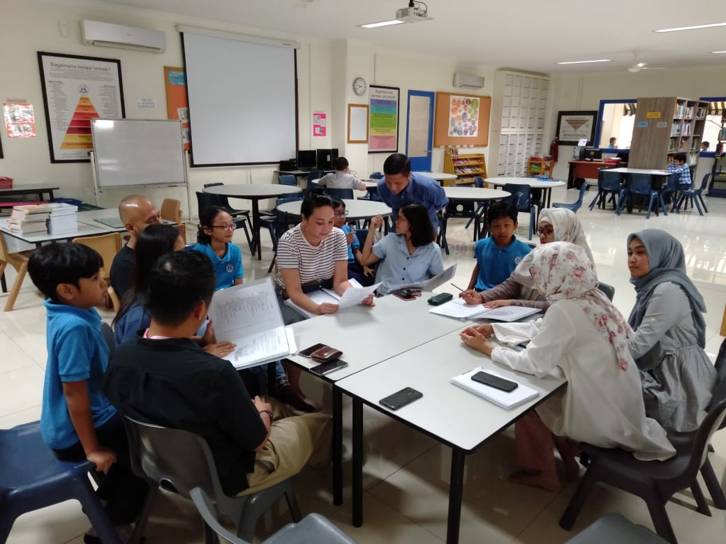
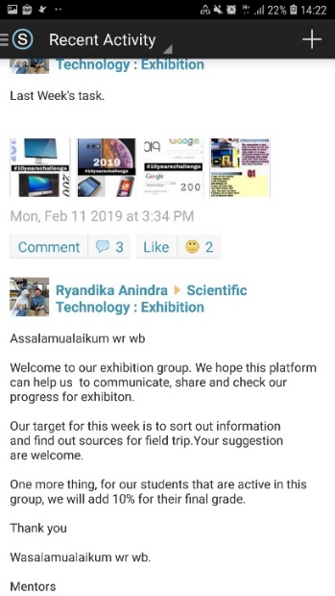
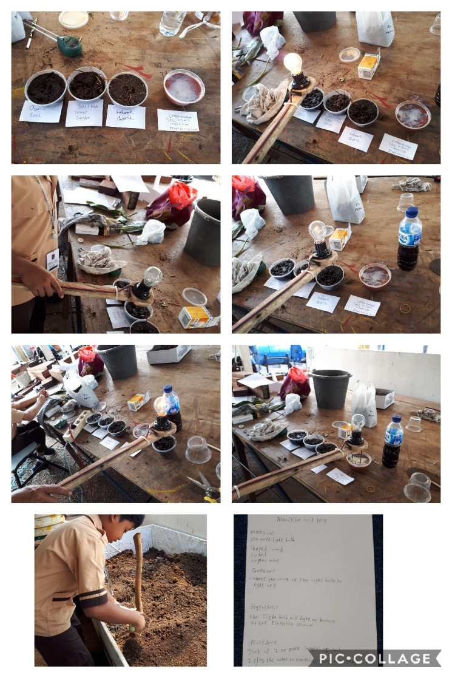
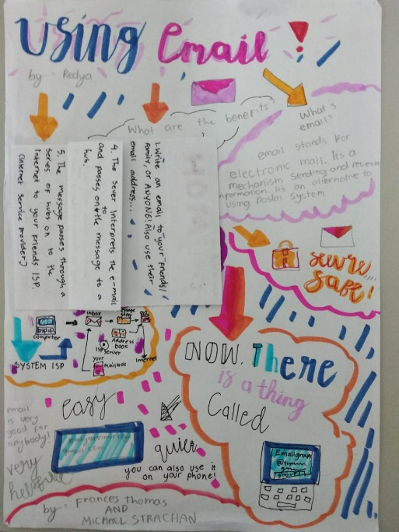
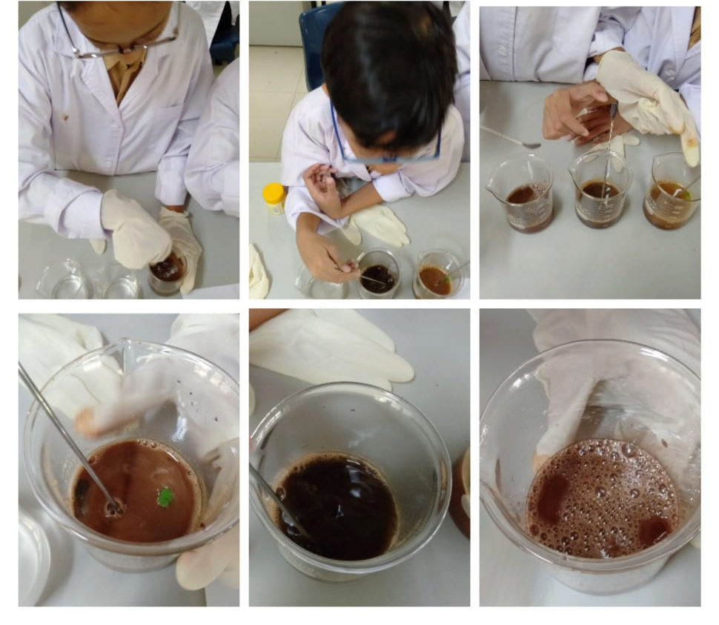
Utilizing approaches to learning:
Communication, Collaboration, & Self management

Slide 6
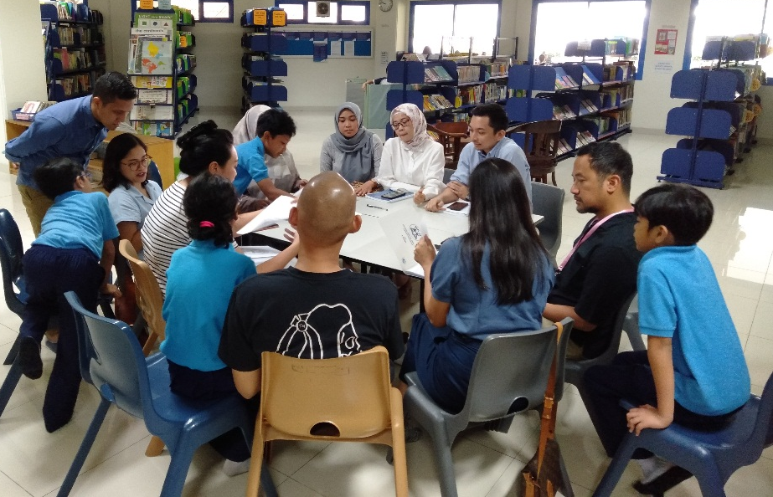
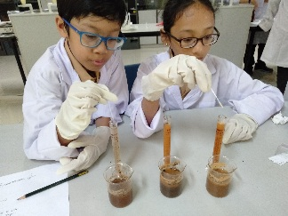
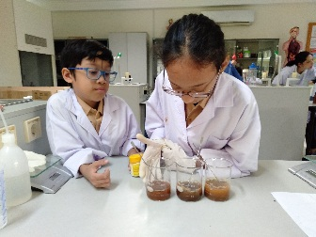
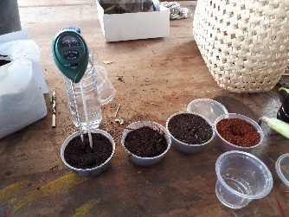
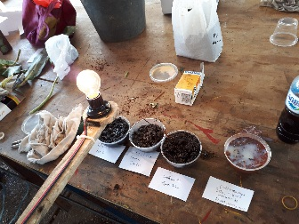
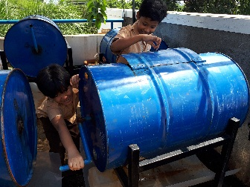
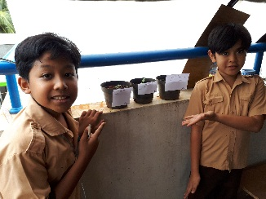
We have meetings to give ideas and we collaborate.
We collaborate to make a technology related to our topic.
We test the experiment and technology to get evidence.
We conducted 6 experiments that involved checking soil health and ways to treat soil health and productivity
Soil testing experiments
Litmus paper
Vinegar & Baking soda
pH digital meter
Soil Nutrient Checker
(SNC).
Compost making
Plant testing

Slide 7
Sets learning goals and success criteria
Learning Goals | Success Criteria
Describe human interaction towards technology | We are able to recognize types of technology
Examine interaction between technology and agricultural systems | We are able to identify advanced technological system
Describe the agricultural activities that could affect the ecosystem | We are able to recognize the contaminants of soil and we know how to decontaminate soil.

Slide 8
Reflects upon and modifies inquiry
Inquiry Process (Generating ideas)
Researched
listed contaminants of soil
Reflection of the learner profiles
knowledge
communicator
Describe what happened)
accepted feedback
connected agricultural activities and technological advances
decided on a specific topic
innovate a simple technology to measure soil nutrients
inquirer
Express feeling
challenging (Blended POI)
fun (experiences)
provide an improvement of technology
field trips
We had not found out our specific field of technology until the 3rd week

Slide 9
Social
Entrepreneurship
Social Justice
Lifestyle Choice
Considers action on learning

Slide 10
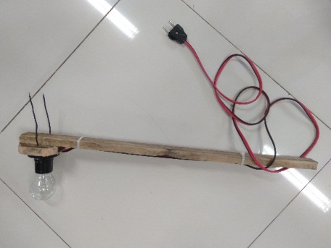
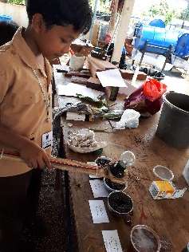
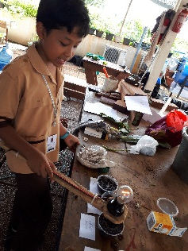
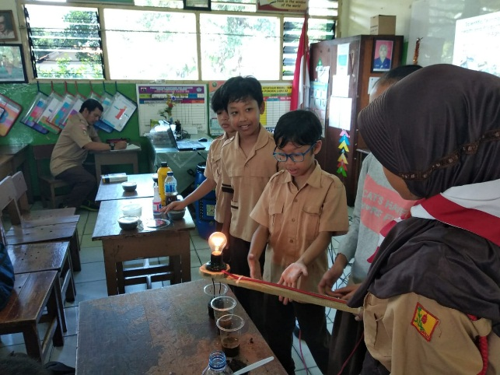
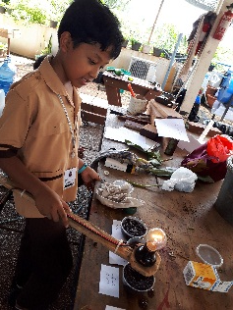
Considers action on learning:
Social Entrepreneurship
designed, planned, and developed models of technology
Soil Nutrient Checker (SNC).

Slide 11
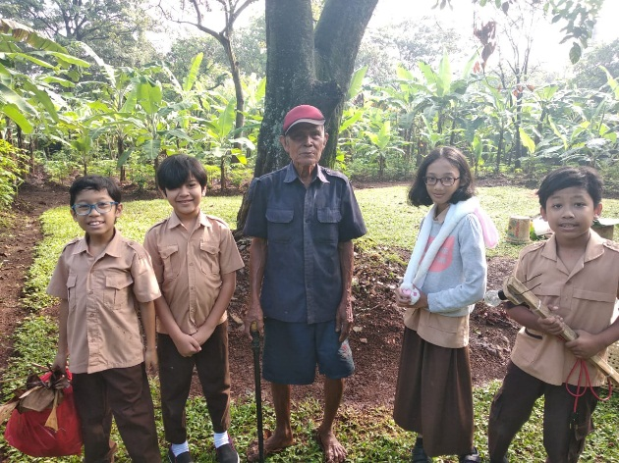
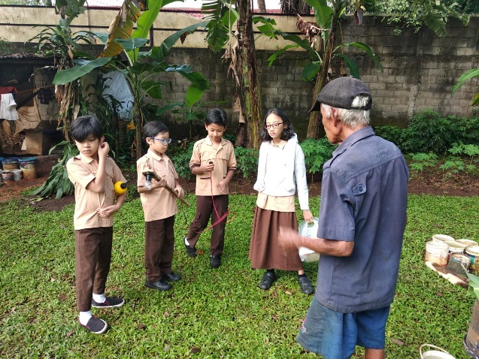
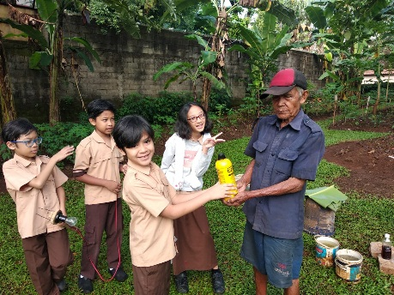
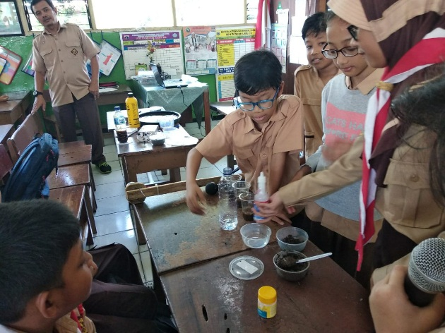
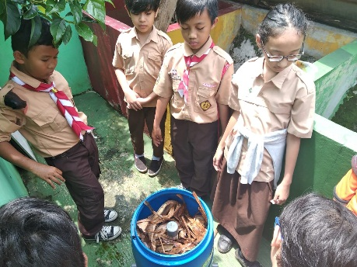
Considers action on learning:
Social Justice
volunteer to share our experiment to the learning community and other community

Slide 12
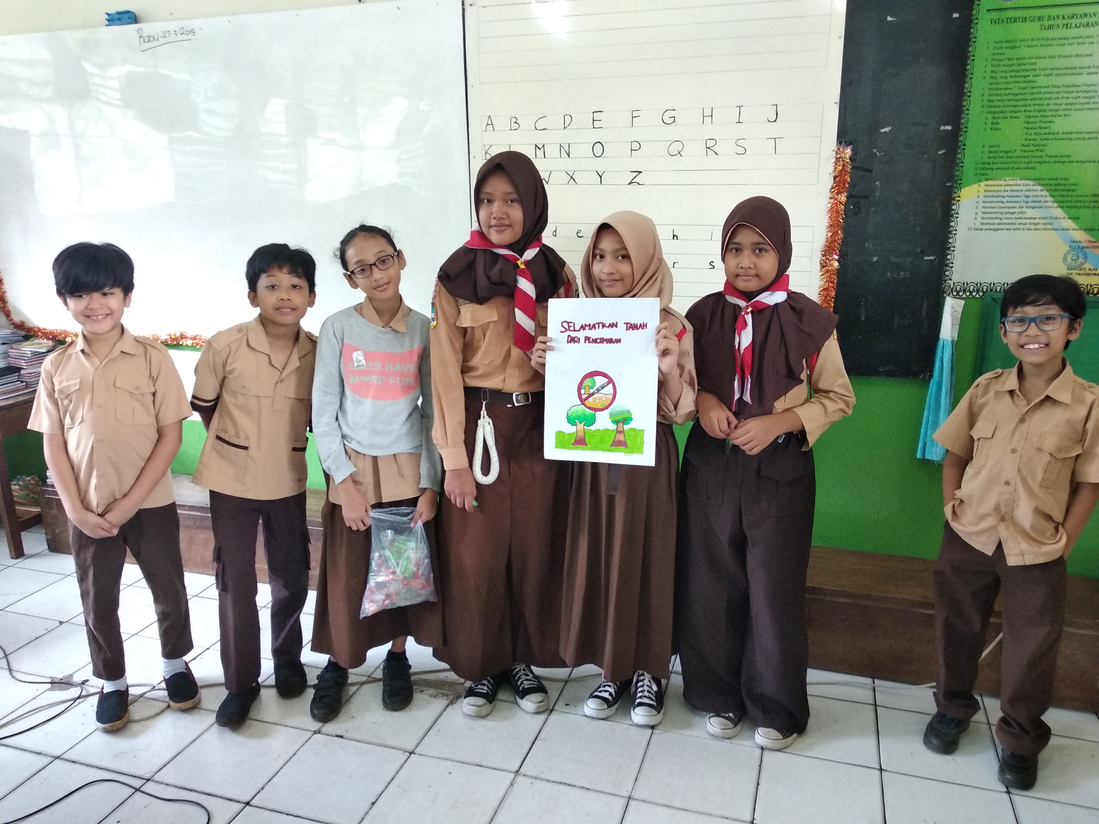
Considers action on learning:
Lifestyle Choice
engage in responsible and sustainable consumption; promote and campaign about eating organic food and promoting the 3Rs..

Slide 13
Self- assesses
Generate artefacts (experimental procedures and models)
Created journal and discuss what they have learned about the central idea
Sometimes, we still don’t bring materials on time
We don’t really update the journal if we are missing something
Idea
Set a reminder to remember our tasks.
Ask our friends if we are missing something or not. If we do, immediately fill it.

