Slide 1
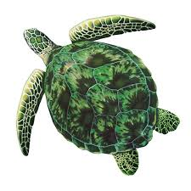
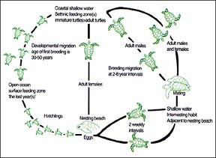
GREEN SEA TURTLE (Chelonia mydas)
DIET
jellyfish,copepods,hydroids,seaweed,sea grass,red algae.
The green sea turtle (Chelonia mydas), also known as the green turtle, black (sea) turtle, or Pacific green turtle, is a large sea turtle of the family Cheloniidae. This species is named for the green color of its fat, rather than the color of its skin or shell as most people think. These turtles shells are in fact olive to black. It is the only species in the genus Chelonia.
Natural Predator: (eggs and hatchling): Racoon, Ghost crab, predatory fish, large sharks.
Nesting and Hatchling:
Nesting/Hatchling season: June-November
Only the females nest, and it occurs most often at night. The female crawls out of the ocean, pausing frequently as if carefully scoping out her spot. Sometimes she will crawl out of the ocean, but for unknown reasons decide not to nest. This is a "false crawl," and it can happen naturally or be caused by artificial lighting or the presence of people on the beach. Sea turtles are generally slow and awkward on land, and nesting is exhausting work.
Life cycle
Habitat:
The youngest juveniles feed at open ocean fronts and “weedlines.” But for the rest of their lives, green sea turtle graze on seagrasses or algae within shallow seagrass pastures, reefs, and “hard bottom.” Nesting femalales need soft, sandy beaches with natural dunes.
Threats
-MARINE PLASTICS are an ingestion hazard.
-ILLEGSL HUNTING for meat.
-NESTING DISTRUCTION inclucing light, noise, etc.
-OVER FISHING capture and drown turtle.
How to help:
-pick up marine litter
-contribute to marine conservation organization
-hide lights visible from beaches
So now do you conscious to be caring

