Slide 1
CRUSHED FALLEN LEAVES TO SEED GERMINATION
TEAM MEMBERS:
NAYA, AURA, BUDI, DARRYL, RASHA, RACHEL
MENTORS:
MS.SASRI, MS.EVA, MS.ULFAH

Slide 2
PROBLEMS
People just throw the leaves like the leaves don’t have any positive side effect or any advantage.
People don’t know what is the positive side effect of using the fallen leaves.

Slide 3
HYPOTESIS
People should know the advantages of the fallen leaves.
The advantages of the fallen leaves is, that you can make compost from the fallen leaves to help your plant.

Slide 4
WHAT WE ARE GOING TO DO
We are taking data from 4 different pots with different materials.
Our objective is to find out the tallest, he most fertile green bean plant and why it can grow better than the other pots.
These are the 4 different pots.

Slide 5
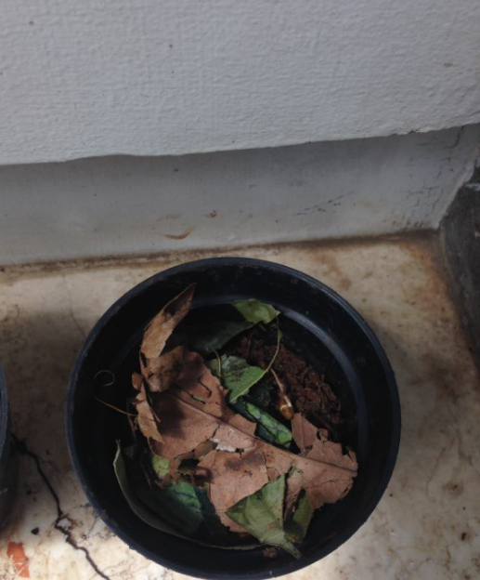
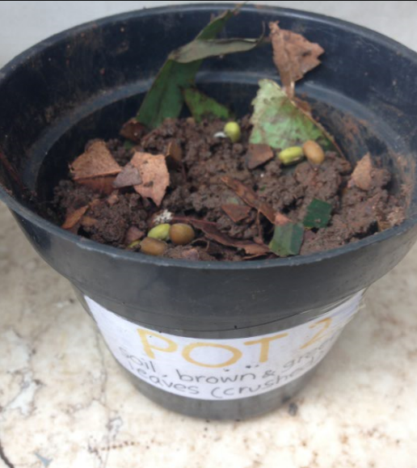
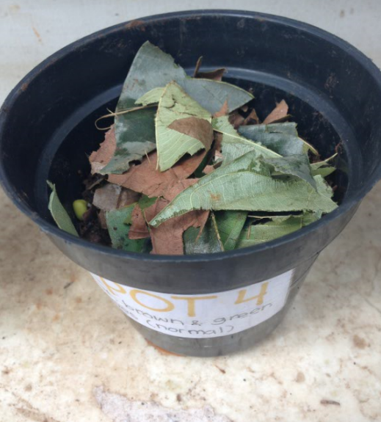
POT 1
POT 2
POT 3
POT 4

Slide 6
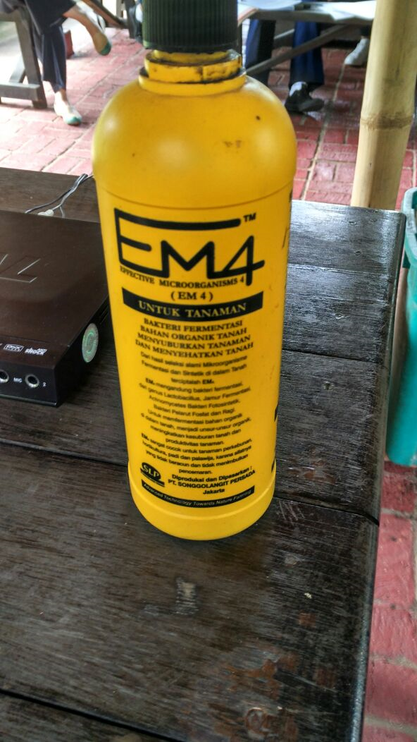
THIS IS THE BACTERIA THAT WE USE FOR THE ACTIVATOR (HARMLESS)
This is the bacteria that we mixed with the brown sugar and water to make the leaves clean and healthy.

Slide 7
THE MATERIALS THAT WE USE IN THE 4 DIFFERENT POTS ARE:
Pot 1 : soil, water, green beans, compost.
Pot 2 : soil, crushed brown and green leaves,
water.
Pot 3 : soil, brown and green leaves with
activator, green beans.
Pot 4 : soil, brown and green leaves, water.

Slide 8
DATA OBSERVATION (HEIGHT)

Slide 9
Our Conclusions
The conclusion from our experiment is pot 3 has the tallest plant out of the other 3 pots.
The reason that pot 3 is the tallest plant is because pot 3 has an activator in it.
And the compost that we use has already used an activator.
So it double the process speed.

Slide 10
THE INFORMATION THAT WE GOT FROM KEBUN KARINDA

