Slide 1
Butterfly Observation
Katya – 5B

Slide 2
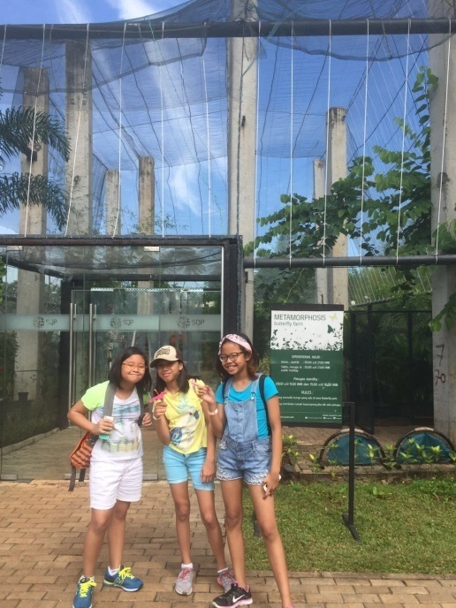
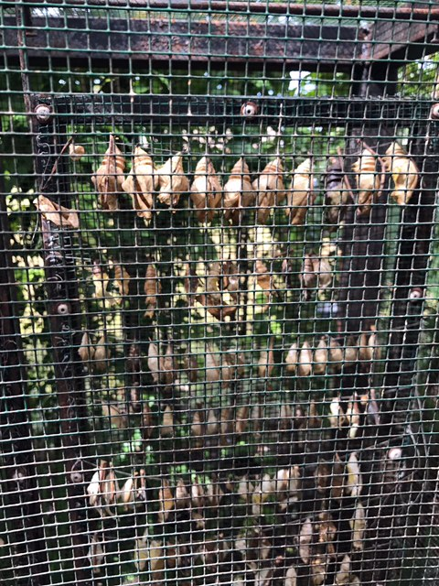
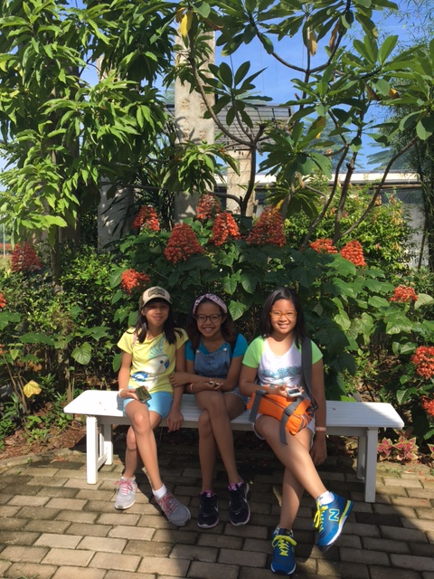
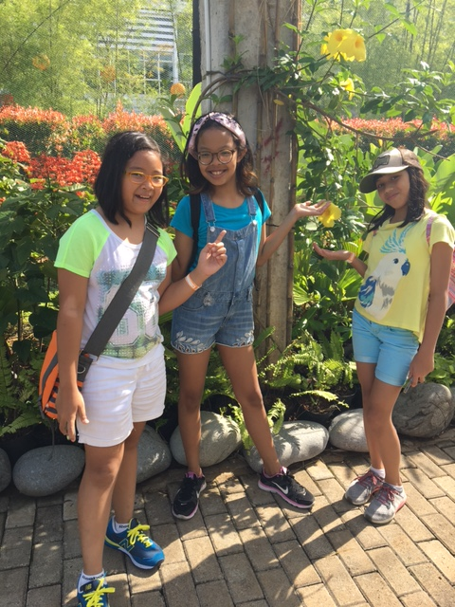
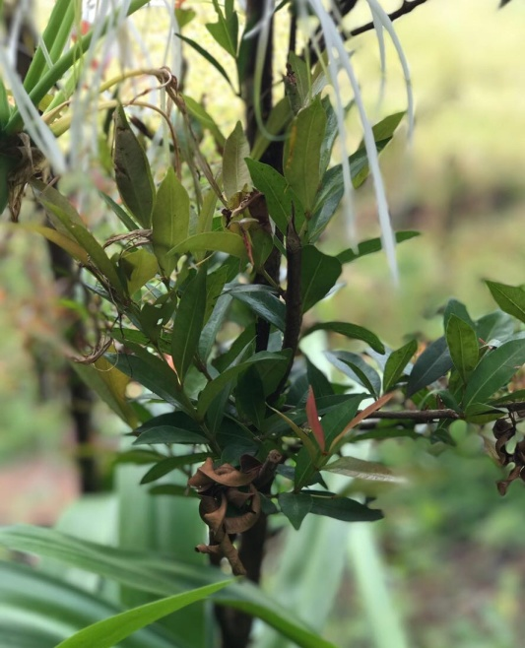
Scientia Park

Slide 3
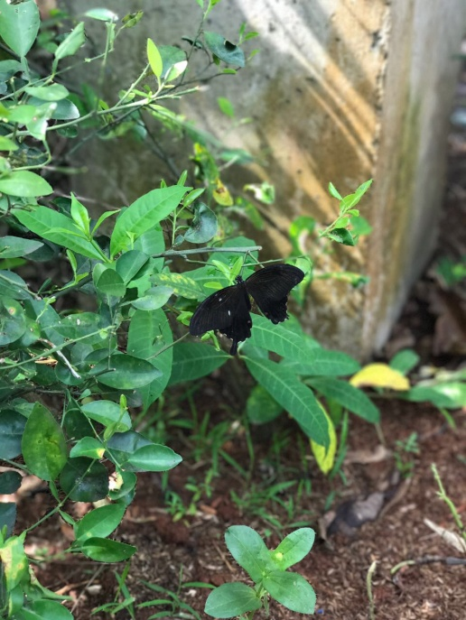
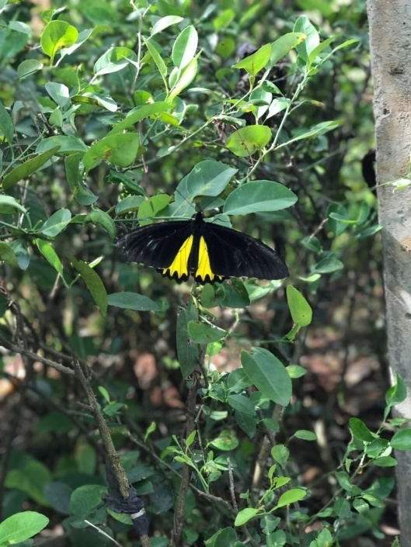
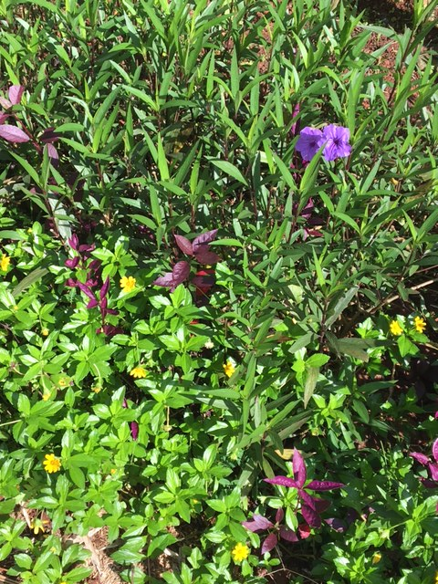
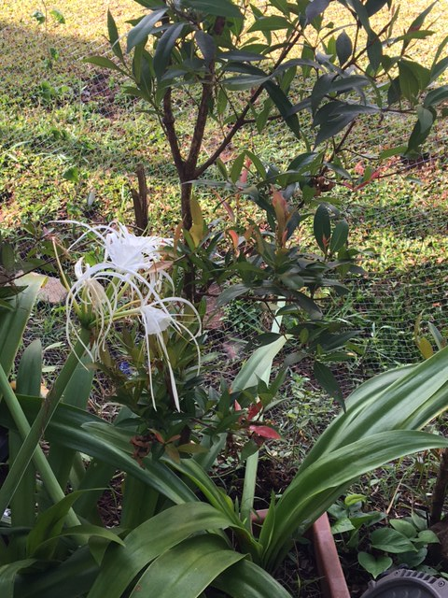
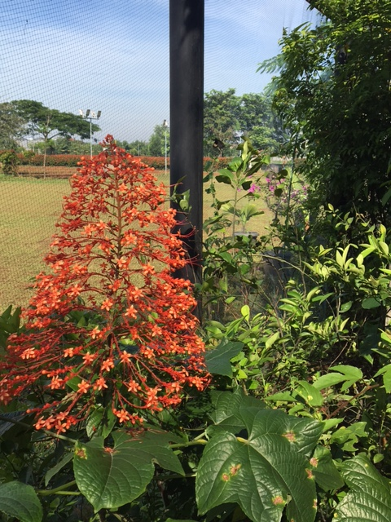
Scientia Park

Slide 4
Scientia Park
There were about 5 butterflies and they are all different and unique
The park keeps the pupa in one big box but the butterfly already emerged from the pupa
We also found a lot of common plants that butterflies drink the nectar from
We saw a pupa that was already dead
And I just have known that a green colored pupa means it just formed into a pupa

Slide 5
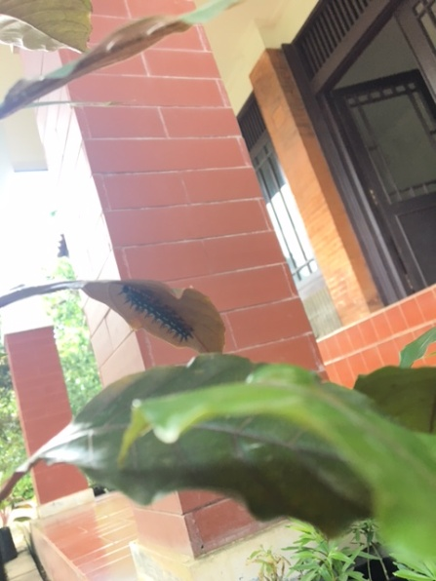
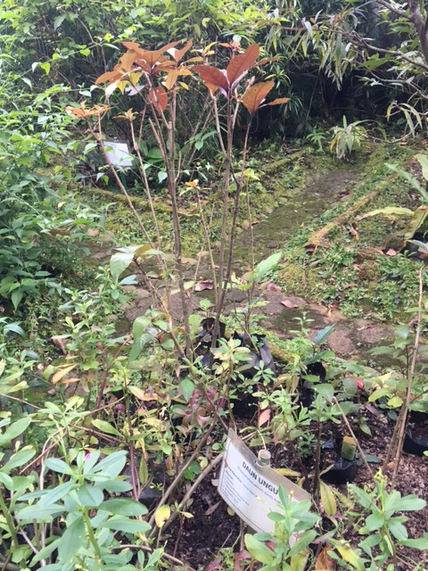
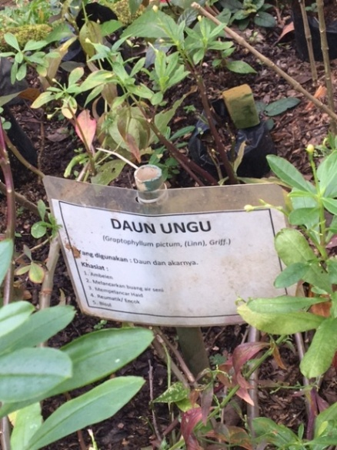
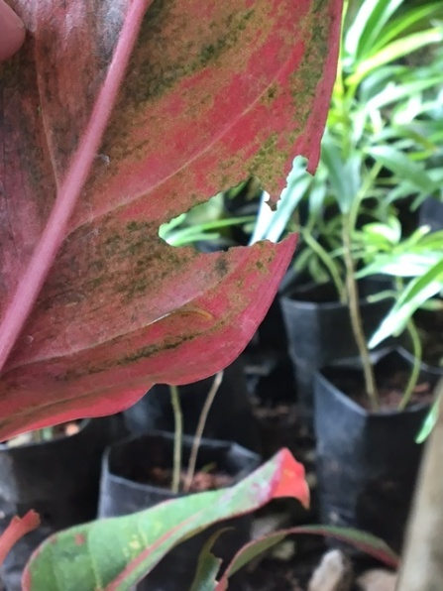
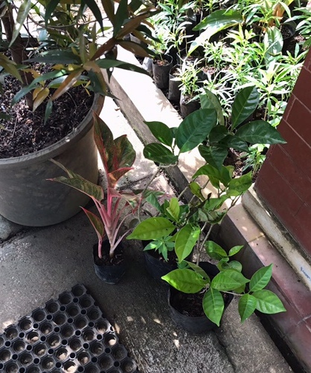
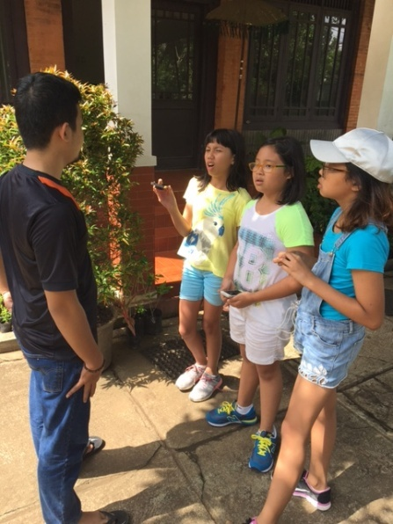
Puri Bunga Seruni

Slide 6
Puri Bunga Seruni
This place has a lot of plants that I do not know yet, in fact, there are several plants that are for the catterpilars, the pupa and the butterflies
We saw only one huge, spiky caterpillar
They used to have a lot of pupa in some of the trees, but now they rarely see them again
Sometimes they threw away the caterpillars in the plants (if there are a lot of them) because it causes the leaves to be broken

